Slide 1


TESLA
SAFE-T: Chip Malware Analytics
Brought to you by Team 4:
Ernest Ang | Jaylene Koh | Ong Qing Qing | Low Qi Hui | Siah Wen Zhao
Business Problem/Analysis
Data Cleaning/ Exploration
Data
Visualisation
Association Rules
Building A Predictive Model
Insights &
Solutions

Slide 2
THE ELECTRIC VEHICLE INDUSTRY
SALES OF ELECTRIC VEHICLE
GLOBAL WARMING
STRONG REGULATORY SUPPORT
29%
Expected CAGR
from 2021 to 2026.
30%
US Global Warming emissions due to transportation sector.
15
Countries to phase out gas-powered cars by 2035.
28%
New cars sold will be EVs in 2030.
600%
Increase in area of forest burned per degree increase.
$30 MIL
Invested in Singapore’s EV related initiatives
WEN ZHAO
Business Problem/Analysis
Data Cleaning/ Exploration
Data
Visualisation
Association Rules
Building A Predictive Model
Insights &
Solutions

Slide 3

TARGET COMPANY: TESLA
Developing Electric & Self-driving Vehicles Since 2003, Largest Market Share
Aims to Reduce Carbon Footprint
Accelerate World’s Transition Towards Sustainable Energy
WEN ZHAO
Business Problem/Analysis
Data Cleaning/ Exploration
Data
Visualisation
Association Rules
Building A Predictive Model
Insights &
Solutions

Slide 4
BUSINESS PROBLEM
Safety
Danger of Autonomous Vehicle
Malware Attacks
Despite autonomous vehicles having a lower accident death rate, individual accidents are getting higher attention from the public that creates impression of Tesla being unsafe
Receives software updates over the air
Prone to external hacking
Increased Competition
More reputable car brands entering EV industry
Tesla should seek to differentiate from its competitors
WEN ZHAO
Business Problem/Analysis
Data Cleaning/ Exploration
Data
Visualisation
Association Rules
Building A Predictive Model
Insights &
Solutions

Slide 5
BUSINESS CHALLENGE
How can Tesla effectively address the safety concerns of its target market to consolidate market share and stay ahead of the competition?
WEN ZHAO
Business Problem/Analysis
Data Cleaning/ Exploration
Data
Visualisation
Association Rules
Building A Predictive Model
Insights &
Solutions

Slide 6
PROPOSED SOLUTION
INPUT: Past Malware Classification Data
SAFE-T
EV Computer Chip Malware Analytics & Predictive Model
Integrate data from other departments
RESULT: Predict whether a computer chip in each Tesla EV will be susceptible to malware → Relevant insights
QI HUI
Business Problem/Analysis
Data Cleaning/ Exploration
Data
Visualisation
Association Rules
Building A Predictive Model
Insights &
Solutions

Slide 7
SAFE-T: THE BENEFITS
RESULT: Predict whether a computer chip in each Tesla EV will be susceptible to malware → Relevant insights
GREATER MARKET SHARE, HIGHER REVENUE:
SAFER CARS, LOWER MARKETING COST
Advanced safety features gives Tesla an edge over its competitors, raking in higher revenue
Safer cars speak for themselves, marketing cost reduced to $0
QI HUI
Business Problem/Analysis
Data Cleaning/ Exploration
Data
Visualisation
Association Rules
Building A Predictive Model
Insights &
Solutions

Slide 8
POC DATA PREPARATION
CLaMP Dataset
Proof of concept for SAFE-T to derive significant insights and detect malware in Tesla’s computer chips.
52 variables
UNDERSTANDABLE FACTOR VARIABLES
EX-DOS File Variables | Various properties which create an image backup of data
Operating System Information | Various properties which record the structure of Portable Executable format and OS
Malware Detection | Whether malware was detected in the computer chip
Models | Simulate three main models that Tesla has (sales department)
Software Version | Four software versions of chips Tesla has had (existing software logging system)
Country | Country where computer chip/Tesla car is
UNDERSTANDABLE INTEGER VARIABLES
Size of Files | Various sizes recorded for different files in the computer chip
Charge Cycles | Number of times Tesla is charged (diagnostic data department)
Car Mileage | How far the car has travelled (diagnostic data department)
LEGEND:
Independent Variables
Dependent Variables
Forged Variables
QI HUI
Business Problem/Analysis
Data Cleaning/ Exploration
Data
Visualisation
Association Rules
Building A Predictive Model
Insights &
Solutions

Slide 9
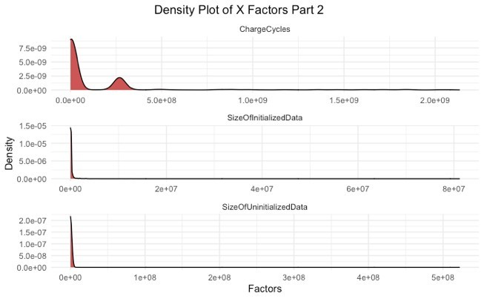
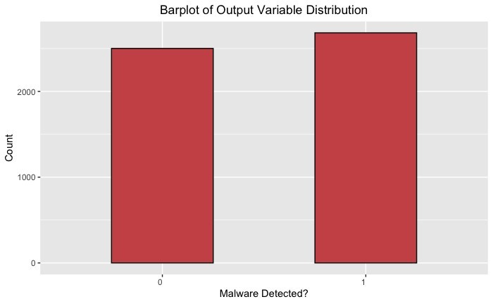
DATA EXPLORATION & CLEANING
1
Removed NA Columns
No effect on model results
2
Did not remove Outliers
No indication data was input wrongly
Small dataset concerns
3
Relatively balanced dataset
SMOTE can be applied if unbalanced, which is very likely in practice
QI HUI
Business Problem/Analysis
Data Cleaning/ Exploration
Data
Visualisation
Association Rules
Building A Predictive Model
Insights &
Solutions

Slide 10
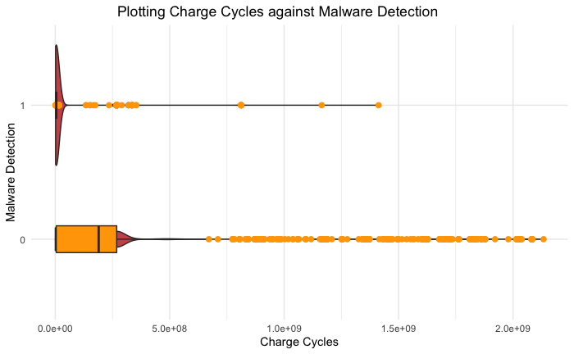
DATA VISUALISATION
Numeric Bivariate Analysis: Malware by Charge Cycles
Distribution of chips with malware detected concentrated in lower range
Evenly spread out for chips with no malware detected
Newer Cars with lesser charge cycles more susceptible to malware detection
QI HUI
Business Problem/Analysis
Data Cleaning/ Exploration
Data
Visualisation
Association Rules
Building A Predictive Model
Insights &
Solutions

Slide 11
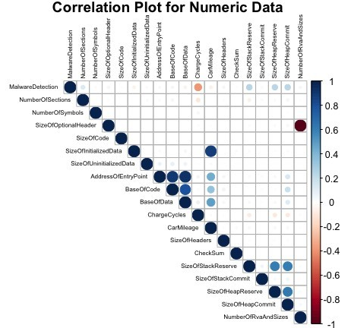
DATA VISUALISATION
Numeric Bivariate Analysis: Correlation Plot
Majority in acceptable range 0
'SizeOfInitializedData' and 'CarMileage' are highly correlated variables
Car that has been used longer→ More data stored in chips
Use variables with lesser correlation to prevent indirect biases
QI HUI
Business Problem/Analysis
Data Cleaning/ Exploration
Data
Visualisation
Association Rules
Building A Predictive Model
Insights &
Solutions

Slide 12
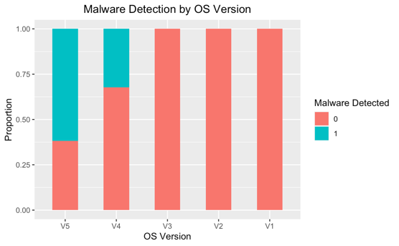
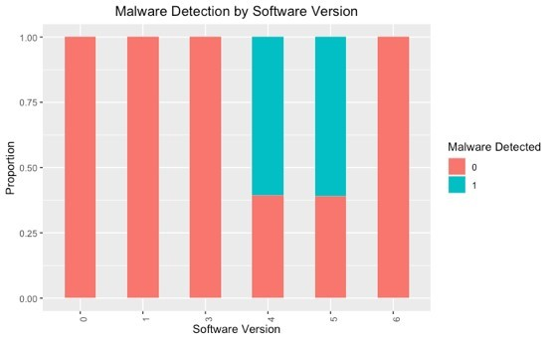
DATA VISUALISATION
Categorical Bivariate Analysis: OS and Software Version by MalwareDetection
Software versions and OS seem to be more likely to have malware detected in the computer chips.
Suggests that latest software developed by Tesla could likely have compromised safety aspect of chip for more functionality
QI HUI
Business Problem/Analysis
Data Cleaning/ Exploration
Data
Visualisation
Association Rules
Building A Predictive Model
Insights &
Solutions

Slide 13
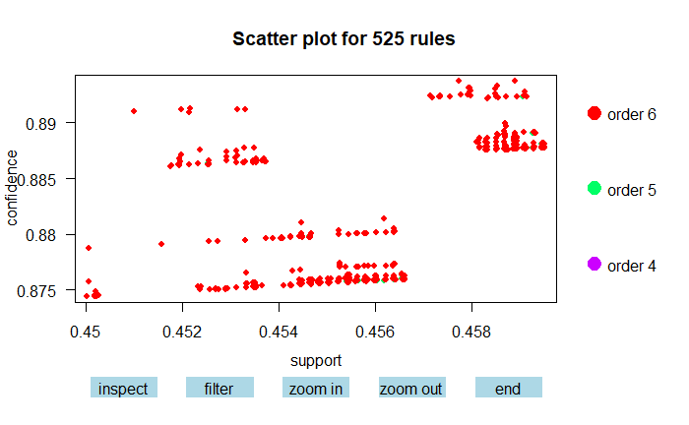
ASSOCIATION RULES
Finding frequent patterns of properties that results in malfunction
Association rules: Associations between features in the dataset and the common trends for when the chip has a detection
Apriori algorithm states that "if an itemset is frequent, then all of its subset must also be frequent"
TwoKey plot: Displaying all discovered association rules at once to get a first overview of the distribution of confidence and support.
JAYLENE
Business Problem/Analysis
Data Cleaning/ Exploration
Data
Visualisation
Association Rules
Building A Predictive Model
Insights &
Solutions
Notes:
In addition to the insights gained from data visualization. association rule mining is performed to gain deeper insights on the associations between features in the dataset and the common trends for when the chip has a detection. We found rules in the form of "if having this set of properties then detection of malfunction“ relationship.
To improve computational efficiency by reducing from all possible rules, we applied apriori algorithm.
The association rules and itemset is visualised by plotting the two key plot graph. The TwoKey plot is a way of displaying all discovered association rules at once to get a quick overview of the distribution of confidence and support.
Order refers to the number of itemset in the data.
From the two-key plot graph generated, we can see that the rules mined mostly have 5 properties on the left-hand side, meaning most detections are associated with a set of 5 properties. Support and confidence seem to be positively correlated.

Slide 14
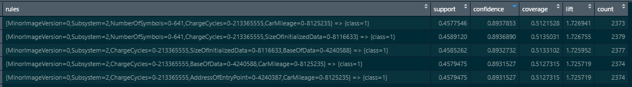
ASSOCIATION RULES
Finding frequent patterns of properties that results in malfunction
Top 5 highest confidence rules mined:
Look out for the frequent patterns of properties that results in malfunction --> We can reduce the production of chips with these properties or alert the sales department to not engage in the sales of these chips
Vice versa, we can look out for frequent patterns of properties that does not result in malfunction -> We can gain insights on what kind of chips should be manufactured and used for electric vehicles that can significantly reduce malfunction
JAYLENE
Business Problem/Analysis
Data Cleaning/ Exploration
Data
Visualisation
Association Rules
Building A Predictive Model
Insights &
Solutions
Notes:
We can also look at the result table to find potentially useful rules automatically from the data by sorting the roles in descending order of confidence to find the rules with the highest confidence. For example, we are the most confident at 89.39% that the set of properties in the first rule will give detection is true. The rule can be applied rather often as the support is high and the high confidence tells us that the rule is strong in situations where it is applicable.
Association rule is especially helpful in helping us look out for the frequent patters of properties that results in malfunction. We can reduce the production of chips with these properties or alert the sales department to not engage in the sales of these chips.
Vice versa, we can also set the right hand side to show no detection to see which set of properties is least likely to give detection is true. And with that, we can gain insights on what kind of chips should be manufactured and used for electric vehicles that can significantly reduce malfunction.

Slide 15
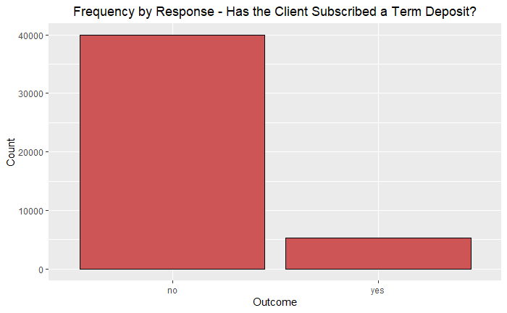
OUTPUT CLASS IMBALANCE
Synthetic Minority Oversampling Technique (SMOTE)
Example of an imbalanced dataset we do not want:
Solution: SMOTE
Frequency by HasDetections – Is there a malfunction in the chip?
Automate checking of output variable and utilised Synthetic Minority Oversampling Technique (SMOTE) to generate synthetic examples for minority binary class, resolving the problem of class imbalance
JAYLENE
Business Problem/Analysis
Data Cleaning/ Exploration
Data
Visualisation
Association Rules
Building A Predictive Model
Insights &
Solutions
Notes:
Prior to fitting our model, we would be performing two methods for data preparation.
As we are collecting the data in real time through stream processing of data which will be further talked about later, we expect to work with very high volume of data. It would be inefficient and not possible to manually check and balance the output variable each time the dataset is changed as we expect new data to be added in continuously. Working with imbalanced data would impact our model performance as most machine learning models will ignore and in turn, have poor performance on the minority class.
Hence, we would automate the checking of the minority class and utilise SMOTE to synthesize new examples from the minority class.

Slide 16
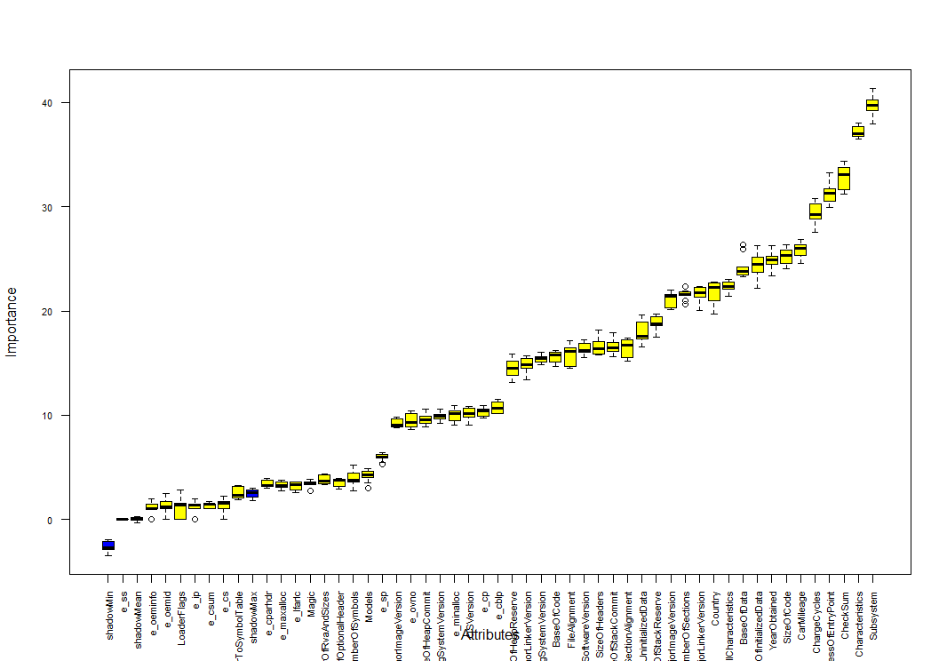
FEATURE SELECTION
Reducing model complexity using Boruta
Plot of Boruta’s result
Model complexity = number of features in the model
Boruta uses a wrapper method that iteratively compares importance of attributes with importance of shadow attributes, created by shuffling original ones.
Follows an all-relevant feature selection method where it captures all features which are in some circumstances relevant to the outcome variable
Boruta’s result table
JAYLENE
Business Problem/Analysis
Data Cleaning/ Exploration
Data
Visualisation
Association Rules
Building A Predictive Model
Insights &
Solutions
Notes:
Since the trained model will be loaded in the chip of the vehicle, we want to reduce the complexity of our prediction model. Due to the limited storage capacity and computational power of the chip, the model cannot be too big and complex. Model complexity refers to the number of features in the prediction model.
To reduce the number of features, an automated feature selection model is used. Boruta uses a wrapper method that iteratively compares importance of attributes with importance of shadow attributes created by shuffling original ones.
In the results table, selected features are confirmed while features that are considered correlated variables, biases or unwanted noises are rejected.
In the plot, we can see the selected features ranked in ascending importance.
Why did we choose Boruta over tradditional methods? nlike traditional methods where they rely on a small subset of features which yields a minimal error on a chosen classifier, Boruta follows an all-relevant feature selection method where it captures all features which are in some circumstances relevant to the outcome variable.

Slide 17
PROPOSED MODEL SOLUTION
LOGSTIC REGRESSION
RANDOM FOREST
NEURAL NETWORKS
Evaluation Criteria
CONFUSION MATRIX
Evaluate model performance based on accuracy, type 1 error and type 2 error.
Higher accuracy and type 1 error
TIME TAKEN
Minimal time taken
JAYLENE
Business Problem/Analysis
Data Cleaning/ Exploration
Data
Visualisation
Association Rules
Building A Predictive Model
Insights &
Solutions
Notes:
We would be considering 3 predictive models in our solution: logistic regression, random forest and neural network.
The best model for our solution will be evaluated based on it's confusion matrix statistics and time taken for prediction.
Confusion matrix allows us to derive a multitude of statistical measurements such as classification accuracy, type I error (false positive) and type II error (false negative) which can be used to compare and evaluate the performances of the different models. We would want a model with the highest accuracy and higher type 1 than type 2 error as we want to minimize missing out on any possible malfunction detection. We would rather give the driver a false alarm and waste some resources than to put the driver at risk in potentially fatal accident.
Different predictive models require different quantities of processing power and time. In this case, time is crucial in alerting and giving the driver more time allowance in stopping the vehicle before an accident is to happen. We want a model with the smallest amount of lag or delay in predicting to maximize the chances of preventing and reducing accidents.
Now I will pass the time to Ernest who will further present on our models.

Slide 18
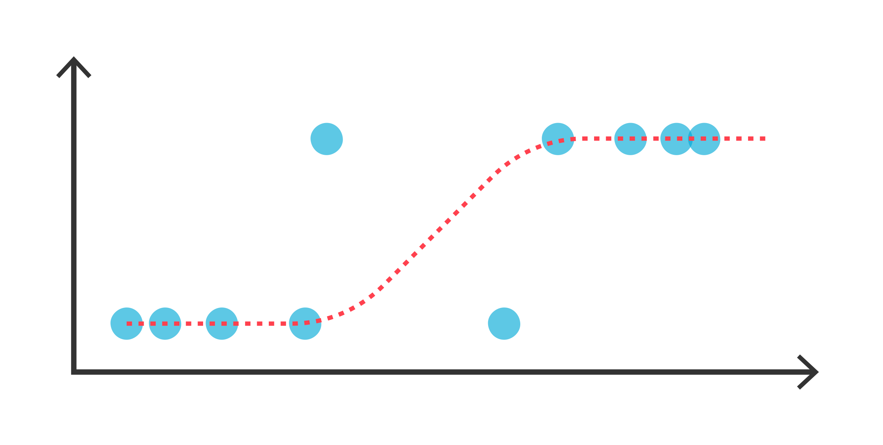
LOGISTIC REGRESSION
Logistic regression model was trained to identify malfunction capabilities
To maximize the full use of the model and ensure that every record in the dataset was used to trained and test the model, K-fold cross validation was implemented with Logistic Regression
2 models were created with and without feature selection to evaluate the performance and necessity of using feature selection
ERNEST
Business Problem/Analysis
Data Cleaning/ Exploration
Data
Visualisation
Association Rules
Building A Predictive Model
Insights &
Solutions

Slide 19
LOGISTIC REGRESSION
Without Feature Selection
With Feature Selection
 | Actual
Prediction |  | 0 | 1
 | 0 | 720 | 55
 | 1 | 30 | 750
 | Actual
Prediction |  | 0 | 1
 | 0 | 701 | 38
 | 1 | 49 | 767
Accuracy: 0.9833, Type I: 0.0280, Type II: 0.0062
Accuracy: 0.9839, Type I: 0.0293, Type II: 0.0037
ERNEST
Business Problem/Analysis
Data Cleaning/ Exploration
Data
Visualisation
Association Rules
Building A Predictive Model
Insights &
Solutions

Slide 20
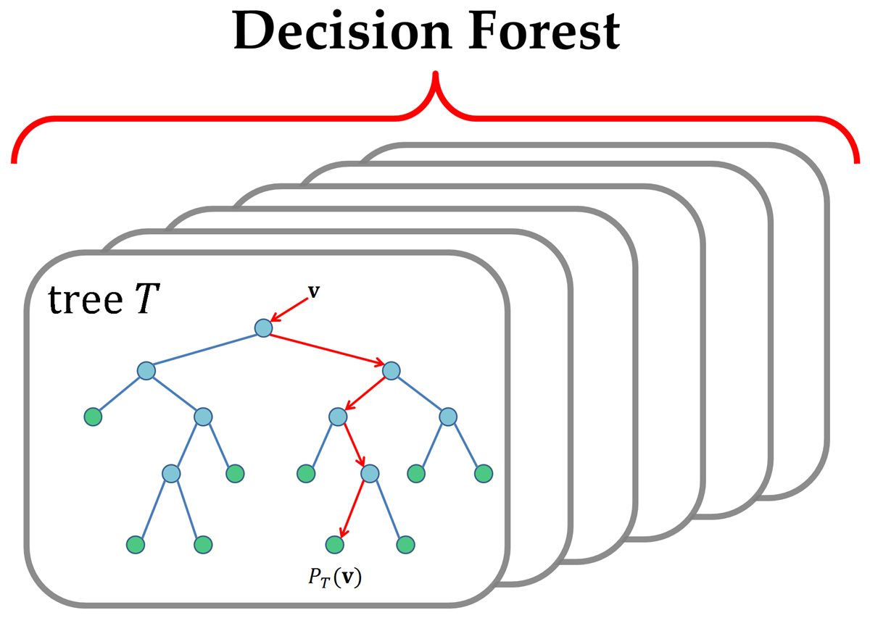
RANDOM FOREST
Random Forest is a supervised machine machine learning algorithm which builds a collection of decision trees to analyze and perform predictions via majority voting/averaging outputs from all of the decision trees
Utilizes bootstrapping to sample the dataset with replacement for each of the decision trees, allowing for consistency in terms of variance within the sampled data
To further increase the performance of the Random Forest, we performed hyperparameter tuning via Grid Search Algorithm specific to tuning Random Forest
ERNEST
Business Problem/Analysis
Data Cleaning/ Exploration
Data
Visualisation
Association Rules
Building A Predictive Model
Insights &
Solutions

Slide 21
RANDOM FOREST
Without Feature Selection
With Feature Selection
 | Actual
Prediction |  | 0 | 1
 | 0 | 729 | 5
 | 1 | 21 | 800
 | Actual
Prediction |  | 0 | 1
 | 0 | 728 | 3
 | 1 | 22 | 802
Accuracy: 0.9833, Type I: 0.0280, Type II: 0.0062
Accuracy: 0.9839, Type I: 0.0293, Type II: 0.0037
ERNEST
Business Problem/Analysis
Data Cleaning/ Exploration
Data
Visualisation
Association Rules
Building A Predictive Model
Insights &
Solutions

Slide 22
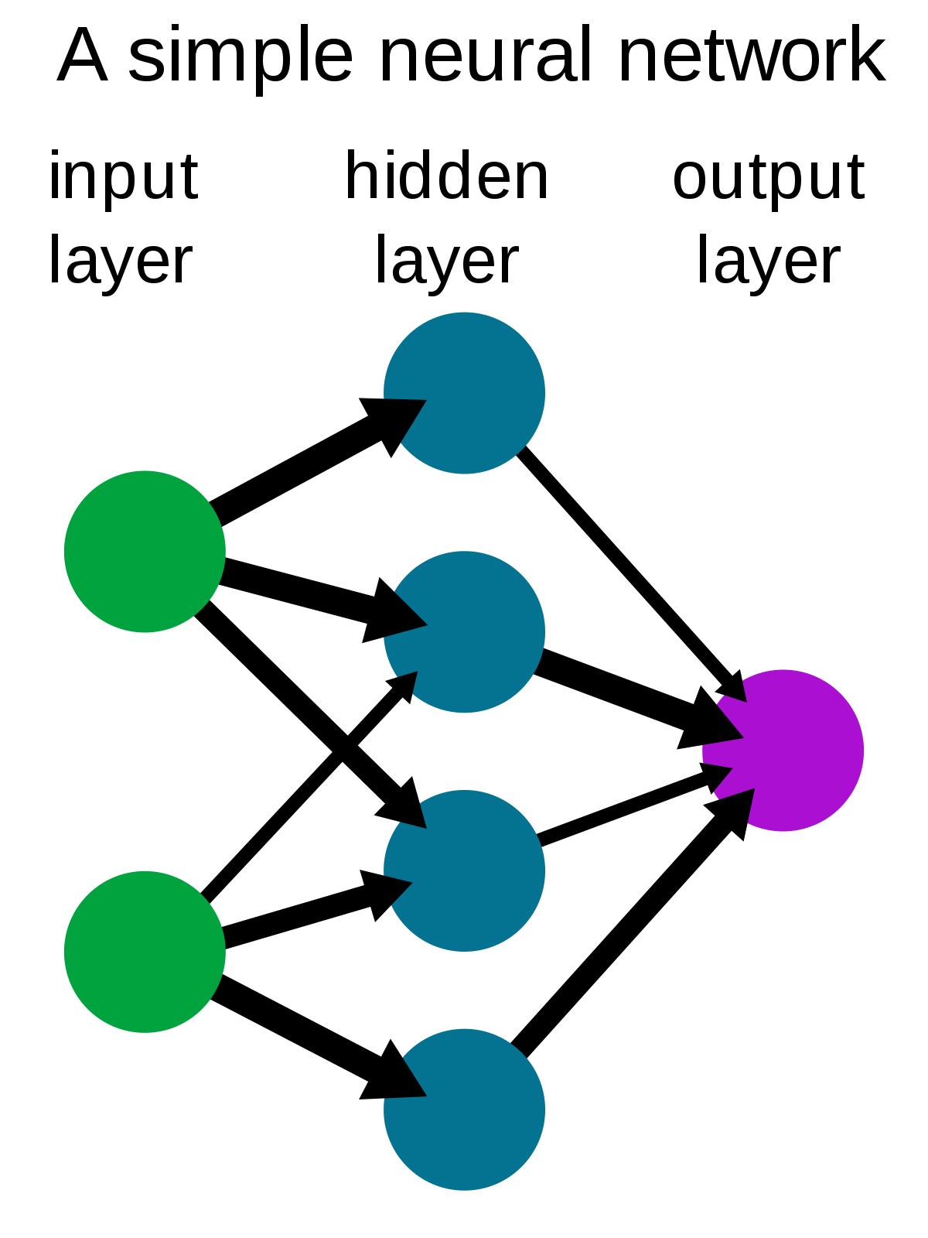
NEURAL NETWORK
A neural network is a deep learning algorithm which actually mimics the human brain in order to determine and predict variables
Each neural network is made up of collection of articifial neurons, otherwise known as nodes, which are organized into different layers of the neural network:
ERNEST
Business Problem/Analysis
Data Cleaning/ Exploration
Data
Visualisation
Association Rules
Building A Predictive Model
Insights &
Solutions

Slide 23
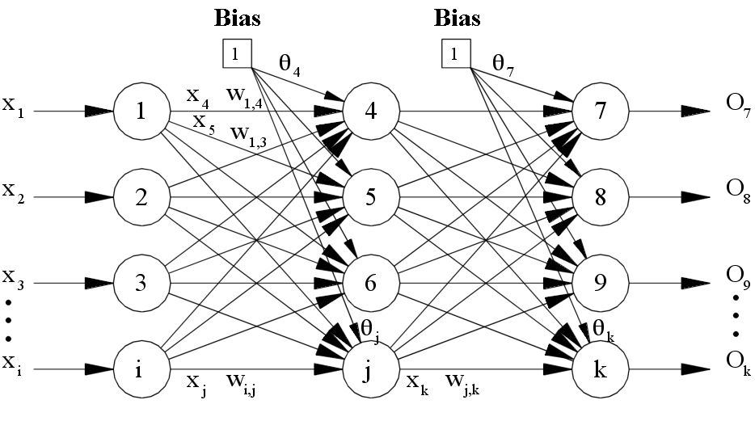
NEURAL NETWORK
Input Layer: Initial input data
Hidden Layer(s): Intermediate layers between the input layer and the output layer
Output Layer: Produce the results which hold the value of the prediction of the variable
Input Layer
Hidden Layer
Output Layer
ERNEST
Business Problem/Analysis
Data Cleaning/ Exploration
Data
Visualisation
Association Rules
Building A Predictive Model
Insights &
Solutions

Slide 24
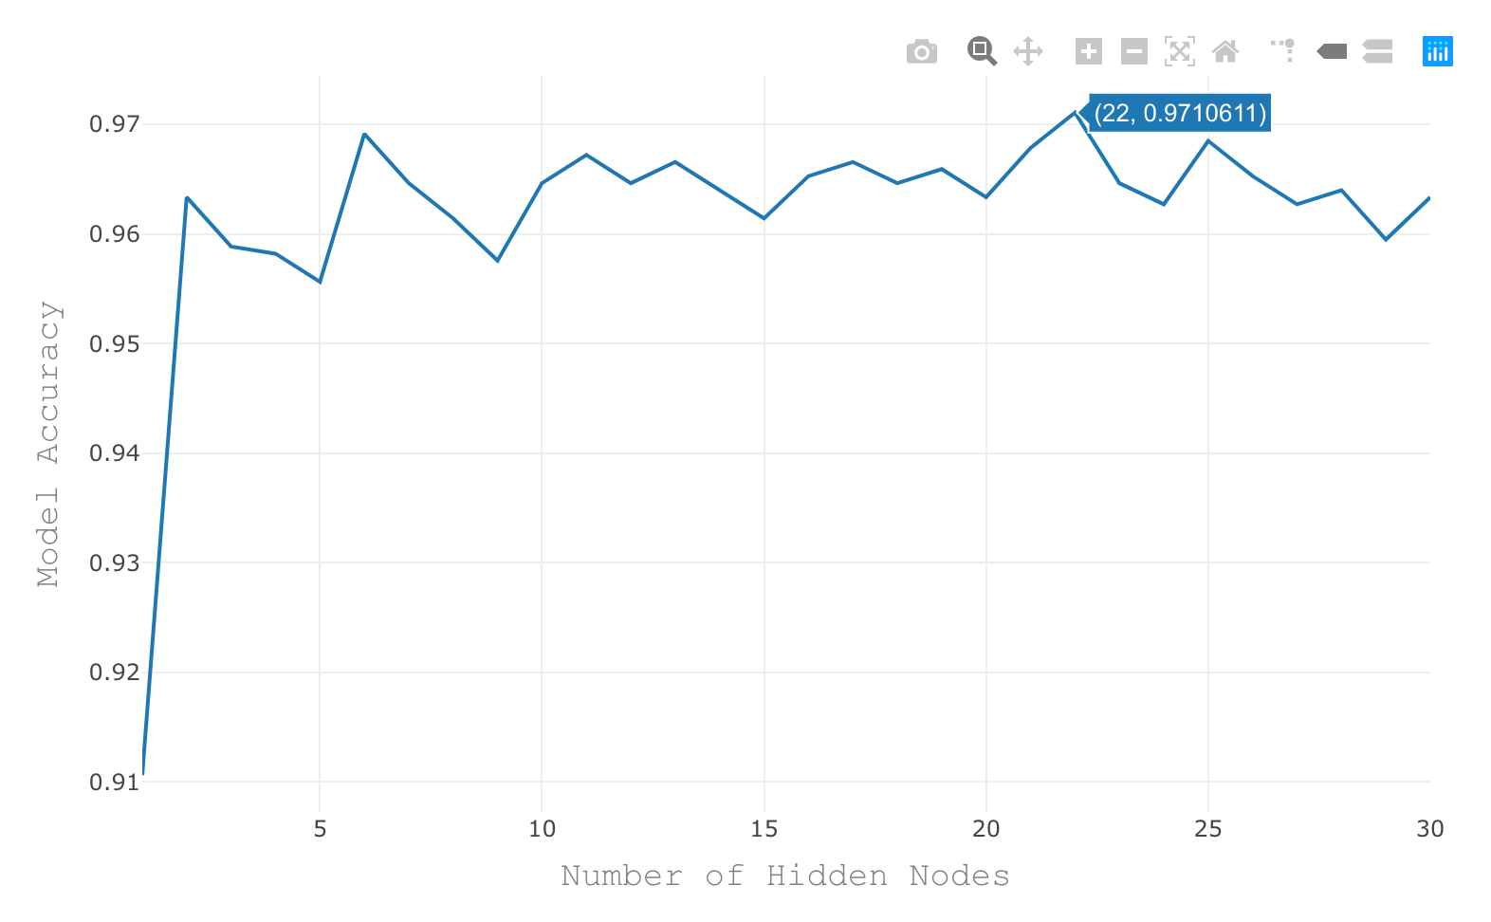
NEURAL NETWORK
ERNEST
Business Problem/Analysis
Data Cleaning/ Exploration
Data
Visualisation
Association Rules
Building A Predictive Model
Insights &
Solutions

Slide 25
NEURAL NETWORK
Without Feature Selection
With Feature Selection
 | Actual
Prediction |  | 0 | 1
 | 0 | 708 | 15
 | 1 | 42 | 790
 | Actual
Prediction |  | 0 | 1
 | 0 | 718 | 38
 | 1 | 49 | 788
Accuracy: 0.9633, Type I: 0.0560, Type II: 0.0186
Accuracy: 0.9685, Type I: 0.0427, Type II: 0.0211
ERNEST
Business Problem/Analysis
Data Cleaning/ Exploration
Data
Visualisation
Association Rules
Building A Predictive Model
Insights &
Solutions

Slide 26
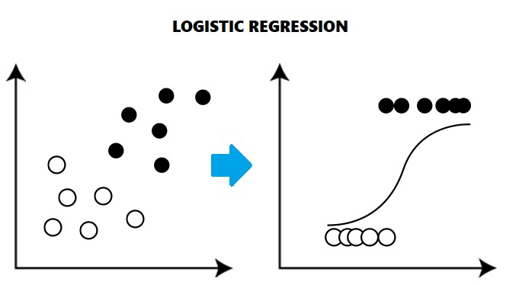
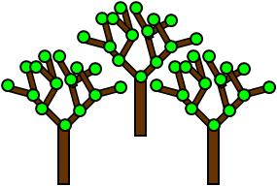

MODEL EVALUATION
Logistic Regression
Random Forest
Neural Network
ERNEST
Business Problem/Analysis
Data Cleaning/ Exploration
Data
Visualisation
Association Rules
Building A Predictive Model
Insights &
Solutions

Slide 27
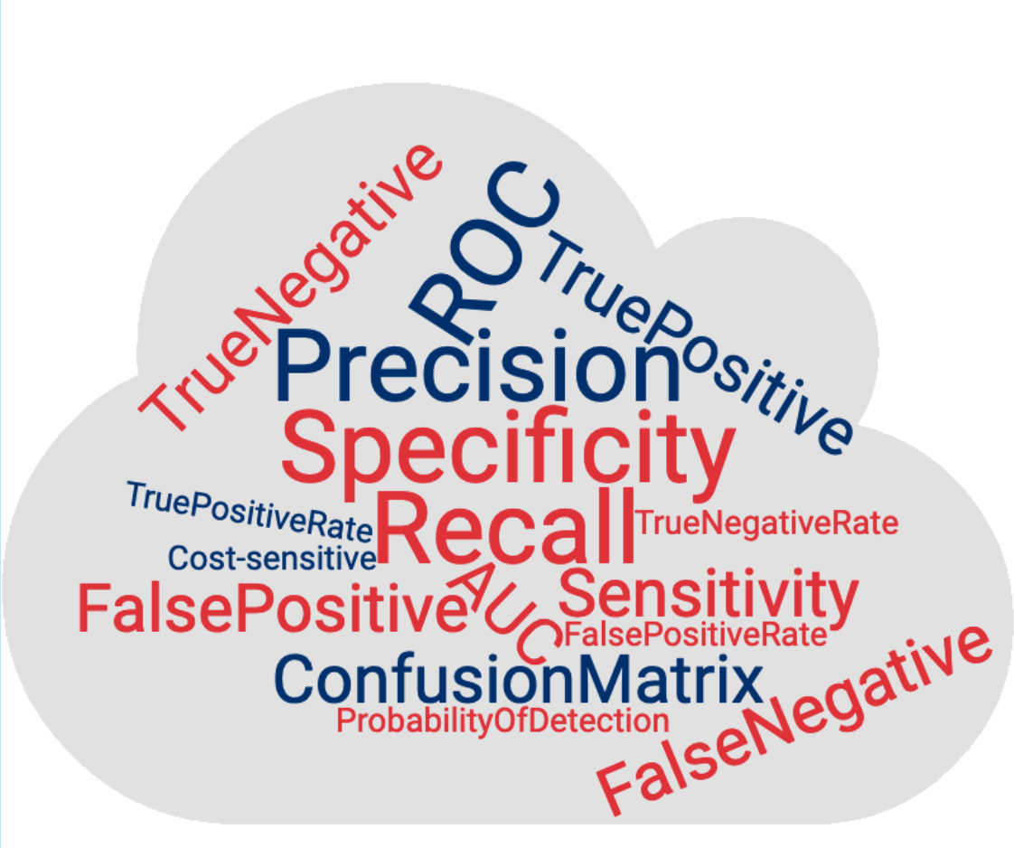
MODEL EVALUATION
Criteria 1: Accuracy:
Random Forest would be the best with an accuracy of over 98% while having the lowest type II error of just 0.3%
Take note that detecting and lowering type II errors should be prioritized over detecting and lowering type I errors
ERNEST
Business Problem/Analysis
Data Cleaning/ Exploration
Data
Visualisation
Association Rules
Building A Predictive Model
Insights &
Solutions

Slide 28

MODEL EVALUATION
Criteria 2: Time and Processing Power
Logistic Regression takes an average of 4 minutes to build
Random Forest takes an average of 5 seconds to build
Neural Network take an average of 50 seconds to build with the optimal number of hidden nodes used - 18
ERNEST
Business Problem/Analysis
Data Cleaning/ Exploration
Data
Visualisation
Association Rules
Building A Predictive Model
Insights &
Solutions

Slide 29
MODEL EVALUATION
Final Choice... Random Forest
ERNEST
Business Problem/Analysis
Data Cleaning/ Exploration
Data
Visualisation
Association Rules
Building A Predictive Model
Insights &
Solutions

Slide 30
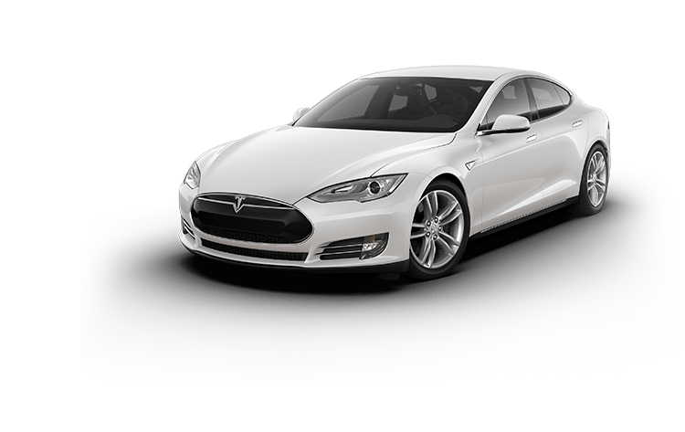
DASHBOARD DEMO
SAFE-T
Machine Learning Solution
QING QING
Business Problem/Analysis
Data Cleaning/ Exploration
Data
Visualisation
Association Rules
Building A Predictive Model
Insights &
Solutions

Slide 31
STAKEHOLDERS
Data Engineers
Client Relations
Chip Engineers
Hyperparameter tuning
In charge of technical optimizations
Reactive approach to malfunctions will improve image of Tesla’s safety
Improve on chip parts based on association rules
HAPPIER AND SAFER CUSTOMERS, HIGHER SALES
QING QING
Business Problem/Analysis
Data Cleaning/ Exploration
Data
Visualisation
Association Rules
Building A Predictive Model
Insights &
Solutions

Slide 32
STREAM PROCESSING
Tesla (IOT Device)
Stream Processing Pipeline
Interactive Dashboard
SAFE-T
Machine Learning Solution
QING QING
Business Problem/Analysis
Data Cleaning/ Exploration
Data
Visualisation
Association Rules
Building A Predictive Model
Insights &
Solutions

Slide 33
ASSUMPTIONS
Sales data can help SAFE-T derive new insights
Utilized sales data (E.g. location of car purchased) as additional variables based on Tesla’s context as a firm
Sample dataset provides a good estimate of actual distributions
Models were rigorously tested
Optimized to predict only on significant features to prevent overfitting
QING QING
Business Problem/Analysis
Data Cleaning/ Exploration
Data
Visualisation
Association Rules
Building A Predictive Model
Insights &
Solutions

Slide 34
BIZ PERFORMANCE MEASURES
FINANCIALS
Year-on-year revenue growth
Strong share price performance
CUSTOMER SATISFACTION
Analysis of online reviews
Market sentiment based on text mining as proxy
ESG MEASURES
Tangible ESG targets (E.g. Carbon emission saved; deaths saved)
Obtain awards and certifications to enhance reputation
QING QING
Business Problem/Analysis
Data Cleaning/ Exploration
Data
Visualisation
Association Rules
Building A Predictive Model
Insights &
Solutions

Slide 35
SAFE-T’S EDGE
ROBUST
Capability to tie in any form of data
Derive new insights and relationships which would not have been found manually
EASY TO INTEGRATE
Data agnostic
Ease of future integration with stream processing
RELIABLE
SAFE-T can be used by many departments
True capability lies in how it can further improve analysis over time
QING QING
Business Problem/Analysis
Data Cleaning/ Exploration
Data
Visualisation
Association Rules
Building A Predictive Model
Insights &
Solutions

Slide 36

CONCLUSION
ROBUST
EASY TO INTEGRATE
RELIABLE
QING QING
Business Problem/Analysis
Data Cleaning/ Exploration
Data
Visualisation
Association Rules
Building A Predictive Model
Insights &
Solutions

Slide 37

THANK YOU!
Any Questions?
QING QING
Business Problem/Analysis
Data Cleaning/ Exploration
Data
Visualisation
Association Rules
Building A Predictive Model
Insights &
Solutions

Slide 38
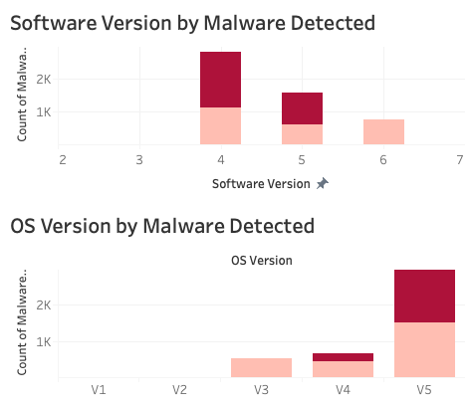
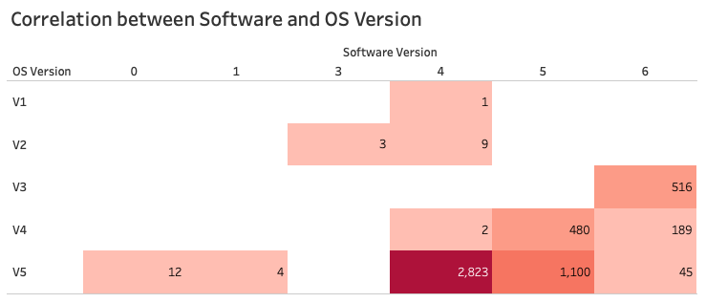
APPENDIX
Visualizations from the Interactive dashboard: OS and Software Version
QING QING
Business Problem/Analysis
Data Cleaning/ Exploration
Data
Visualisation
Association Rules
Building A Predictive Model
Insights &
Solutions

Slide 39
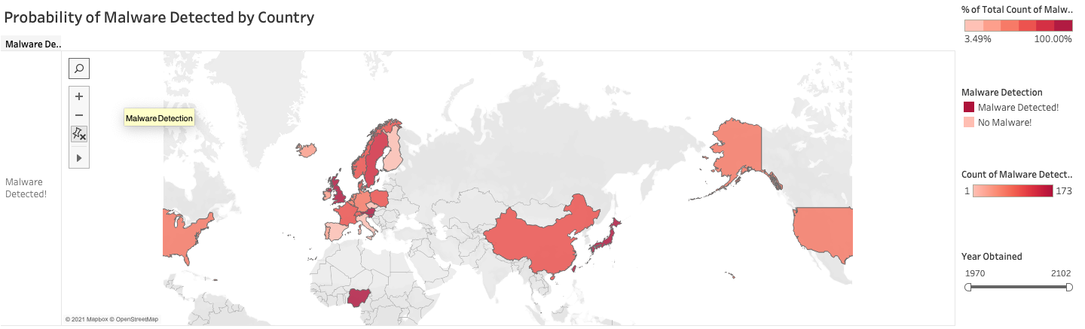
APPENDIX
Visualizations from the Interactive dashboard: Malware Detection by Country
QING QING
Business Problem/Analysis
Data Cleaning/ Exploration
Data
Visualisation
Association Rules
Building A Predictive Model
Insights &
Solutions

Slide 40
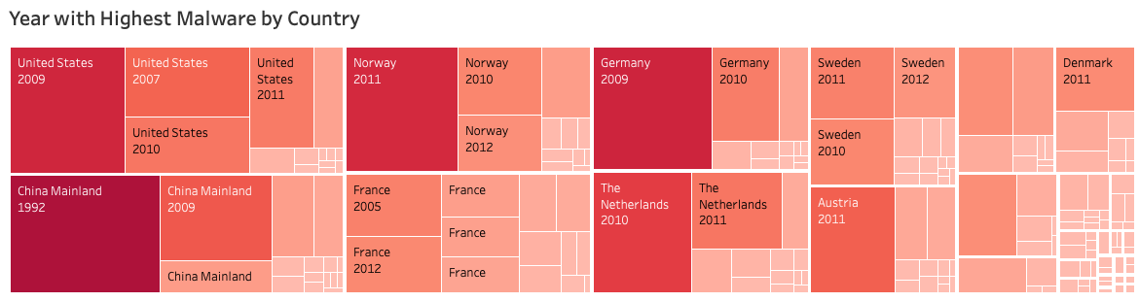
APPENDIX
Visualizations from the Interactive dashboard: Malware Detection by Country by Year
QING QING
Business Problem/Analysis
Data Cleaning/ Exploration
Data
Visualisation
Association Rules
Building A Predictive Model
Insights &
Solutions

